Slide 1
Medical Insurance Cost Prediction
BUSINESS PROBLEM
Low level of consumer awareness and trust Most of the people are unaware/ not fully aware of health insurance products and their benefits. Insufficient data on health insurance consumers, disease patterns and limited control of healthcare delivery network resulting in limited product and pricing innovation.
Pricing and profit for insurance companies. Varying treatment costs across providers and lack of standardization of price is resulting in unreasonable pricing demands by insurance companies is creating the confusions in the mind of the people.

Slide 2
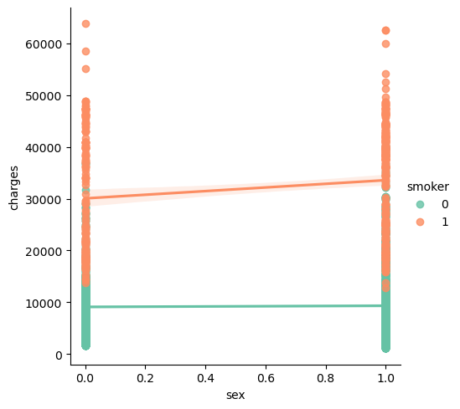
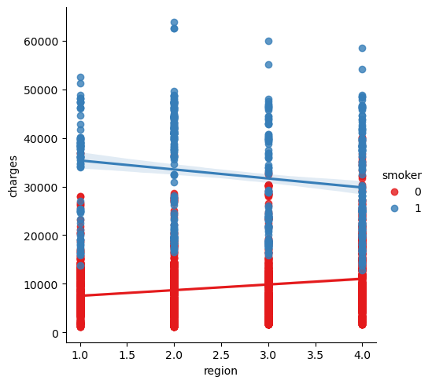
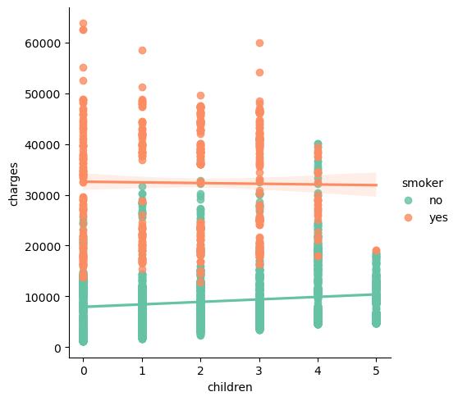
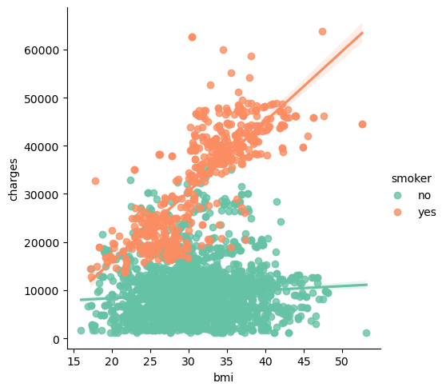
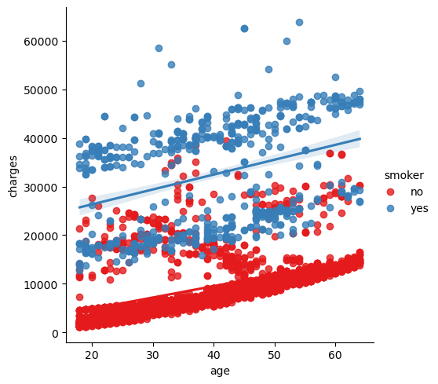
Data Facts and EDA
Name | Description
Age | Age of client
BMI | Body mass index
Children | Number of children the client have
Sex | Male(1) / Female(0)
Smoker | Yes ()1/No (0)
Region | Whether the client lives in southwest(1), southeast (2), northwest (3), or northeast(4)
Charges | Medical Cost the client pay
We had used a dataset which includes 3630 entries for creating our prediction model. This data set includes 7 attributes and the data set
has splitted into two-parts : training data and testing data. To build a predictor model of medical insurance cost the training dataset is applied and to evaluate the regression model,
test set is used.
Conclusions
Sex &region don’t have noticeable differences for each category in terms of charges given.
Children- not a proper trend, however people with lesser no. of children tend to be smokers resulting in paying more charges.
BMI and Age only show differences when smoking as a factor is concerned
Smoking is the most important variable influencing insurance costs.

Slide 3
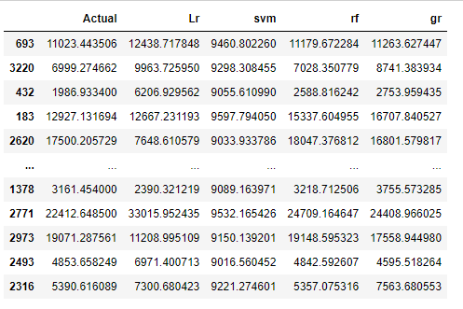
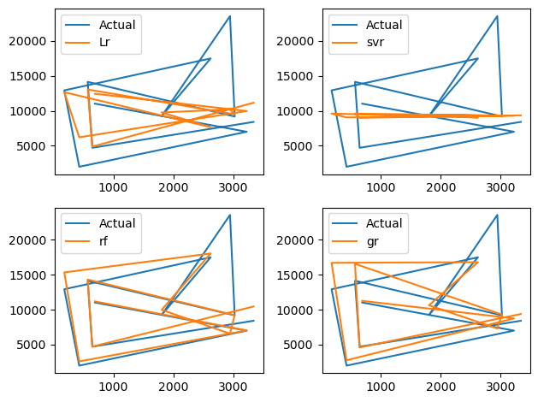
MODEL OUTPUT
Model | R2 square value | Mean Absolute Error
Linear Regression | 0.7207198693175411 | 3831.4095509285594
SVM | -0.099609077735924 | 6899.63563887274
Random Forest Regressor | 0.8986451934529148 | 1482.8423574658864
Gradient Boosting Regressor | 0.8649236688510246 | 2075.4582381521664
The table shows that Random Forest regressor offers
the best efficiency, with an R2 score of approx. 90%.Random Forest Regressor can therefore be used in the estimation of insurance costs with
better performance than other regression models.

Slide 4

Insights and Recommendation
Forecasting insurance prices supported sure factors facilitate insurance suppliers to draw in customers and save time in formulating plans for each individual.
Machine learning can considerably minimize these individual efforts in policymaking, as metric capacity unit models can do cost calculation in a very short time, whereas somebody's being would be taking a protracted time to perform constant tasks.
This may help businesses improve their profitability.
The metric capacity unit models can even manage monumental amounts of data.

